Slide 1

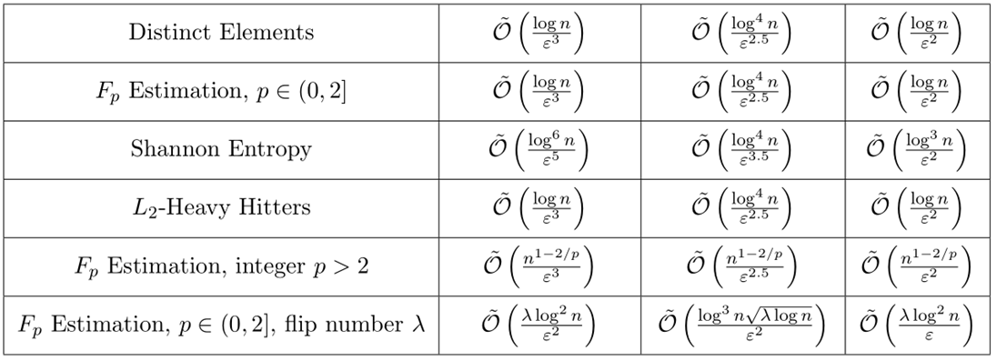
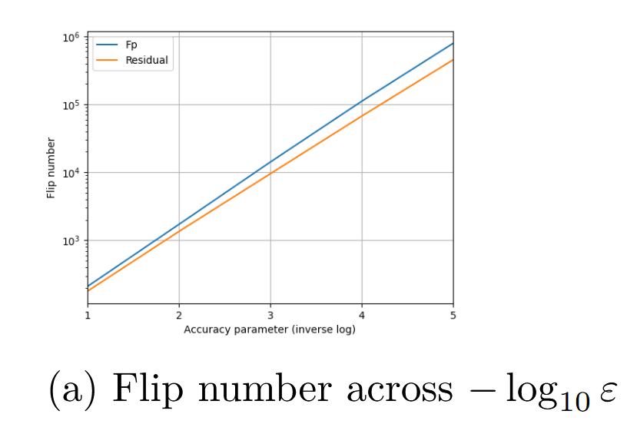
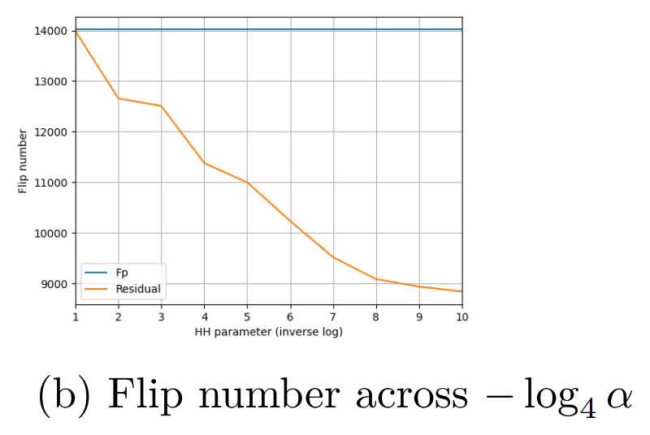
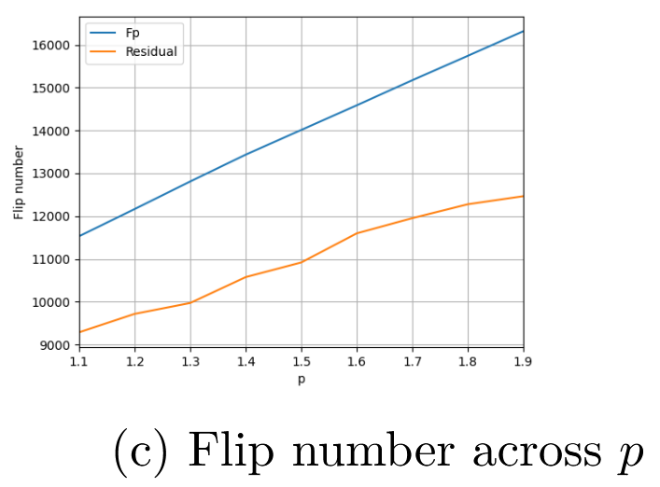
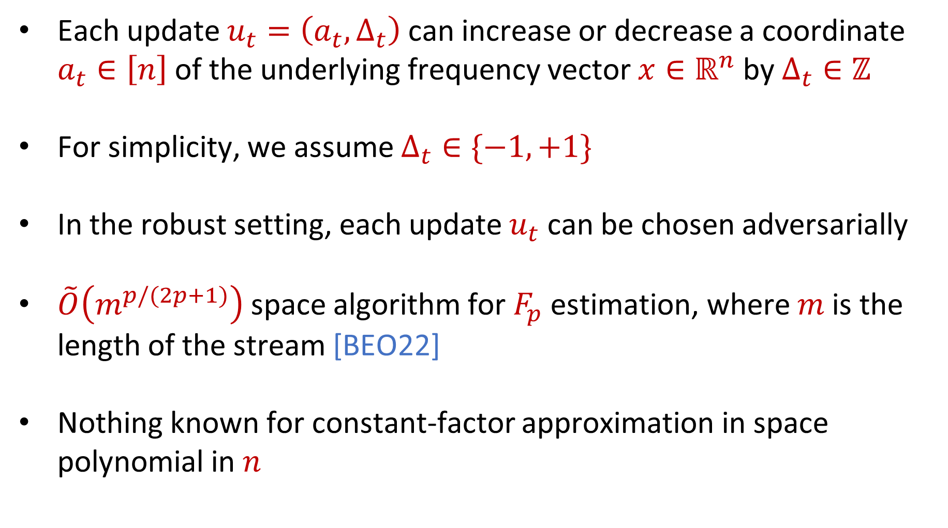
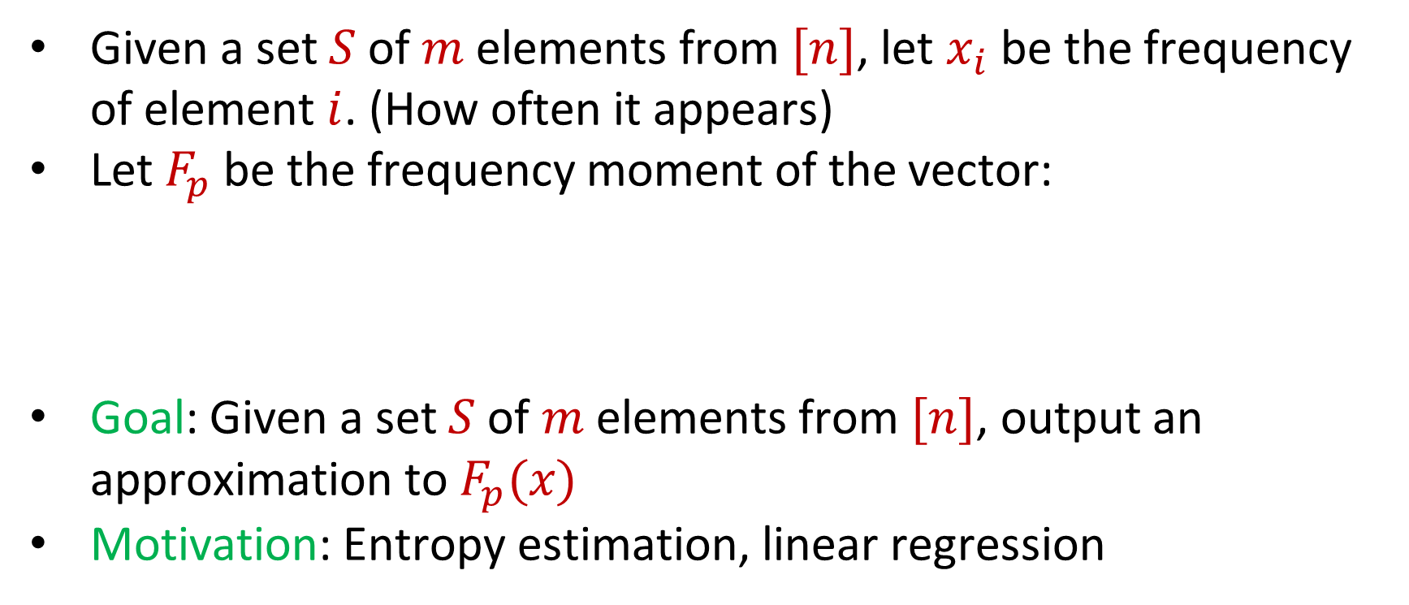
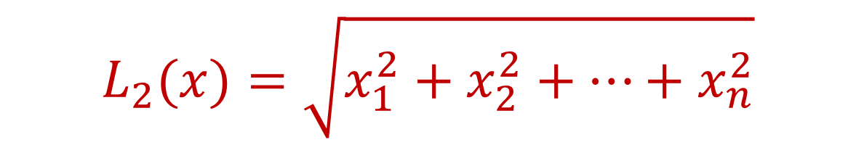
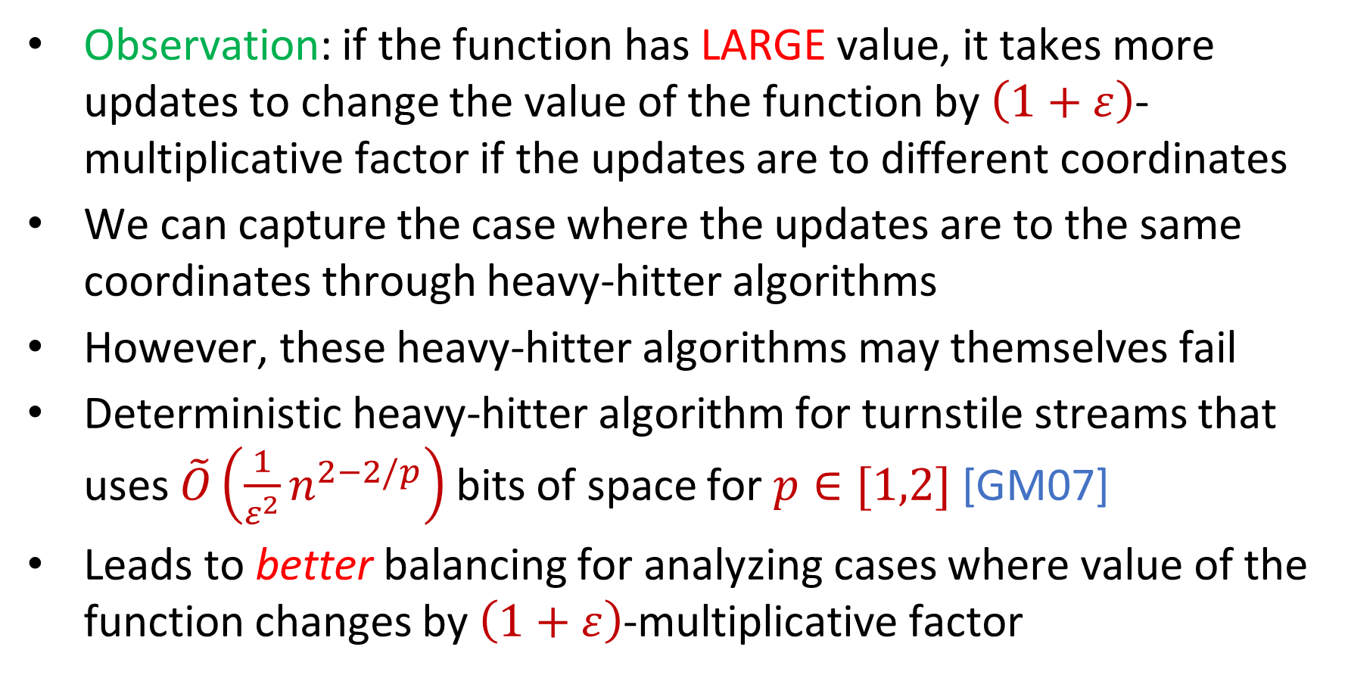
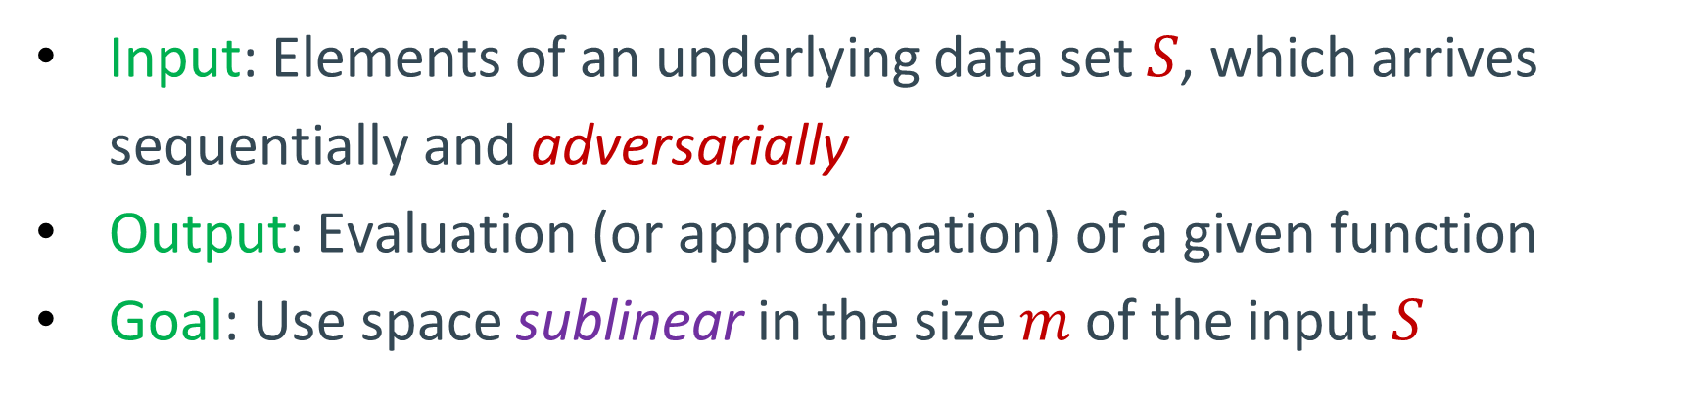
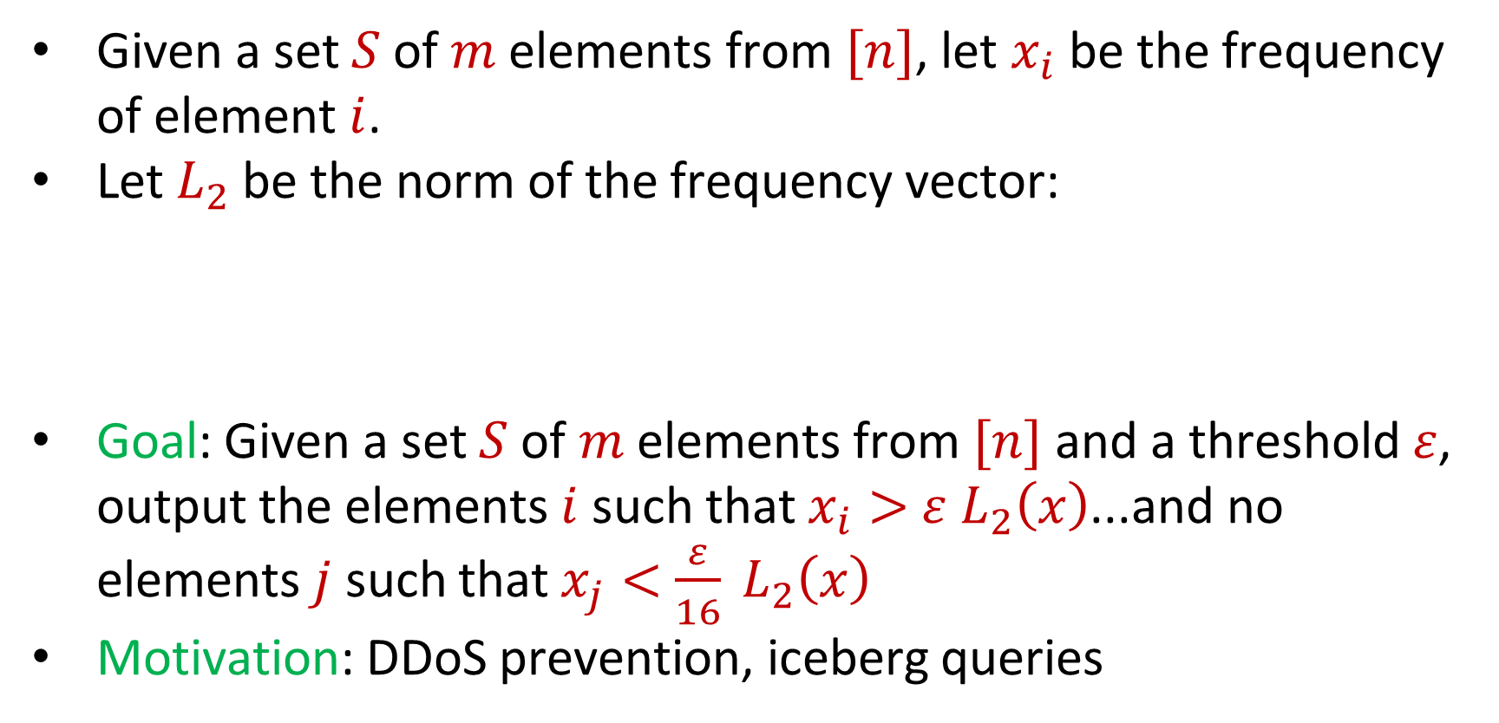
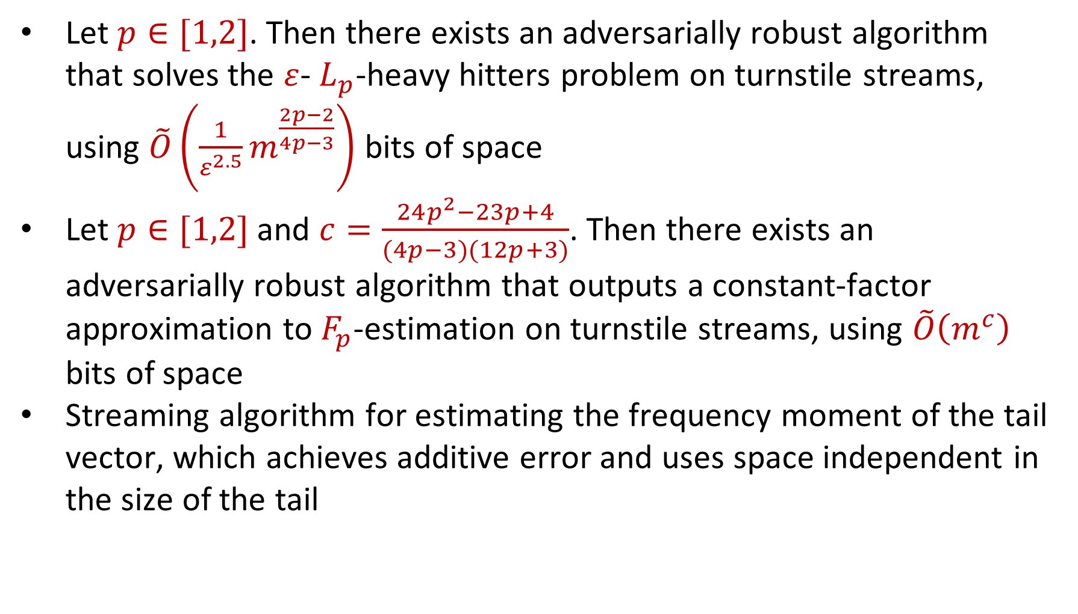
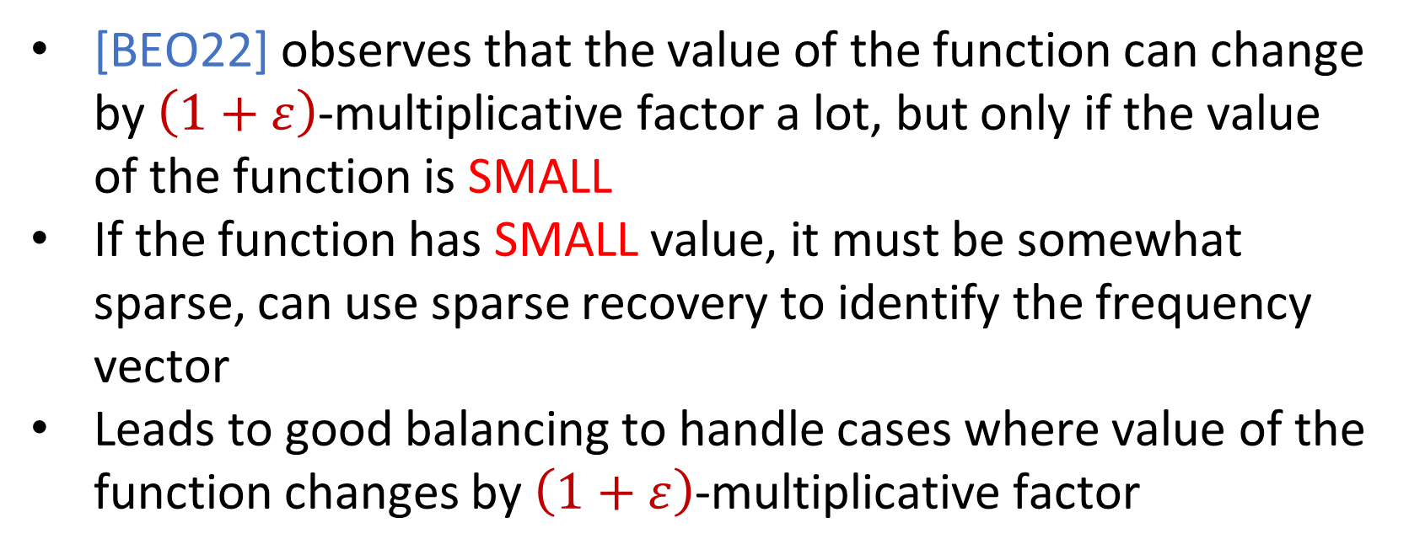
Adversarially Robust Dense-Sparse Tradeoffs via Heavy-Hitters
David P. Woodruff, Carnegie Mellon University and Google Research
Samson Zhou, Texas A&M University
Motivation
Our Results
Insertion-Only Streams
[WZ21]
Algorithms are often evaluated with the assumption that the input is independent of the parameters of the algorithm
Adversary may exploit these parameters to generate adversarial inputs
Multiple interactions with the algorithm may cause future inputs to depend on previous outputs (and thus internal parameters of the algorithm)
[BJWY20]
[HKM+20]
Let $p∈[1,2]$. Then there exists an adversarially robust algorithm that solves the $ε$- $L_{p}$-heavy hitters problem on turnstile streams, using $\tilde{O}\left(\frac{1}{ε^{2.5}}m^{\frac{2p−2}{4p−3}}\right)$ bits of space
Let $p∈[1,2]$ and $c=\frac{24p^{2}−23p+4}{(4p−3)(12p+3)}$. Then there exists an adversarially robust algorithm that outputs a constant-factor approximation to $F_{p}$-estimation on turnstile streams, using $\tilde{O}\left(m^{c}\right)$ bits of space
Streaming algorithm for estimating the frequency moment of the tail vector, which achieves additive error and uses space independent in the size of the tail
Model
Input: Elements of an underlying data set $S$, which arrives sequentially and adversarially
Output: Evaluation (or approximation) of a given function
Goal: Use space sublinear in the size $m$of the input $S$
Techniques
Insertion-Deletion Streams
Observation: if the function has LARGE value, it takes more updates to change the value of the function by $\left(1+ε\right)$-multiplicative factor if the updates are to different coordinates
We can capture the case where the updates are to the same coordinates through heavy-hitter algorithms
However, these heavy-hitter algorithms may themselves fail
Deterministic heavy-hitter algorithm for turnstile streams that uses $\tilde{O}\left(\frac{1}{ε^{2}}n^{2−2/p}\right)$ bits of space for $p∈[1,2]$ [GM07]
Leads to better balancing for analyzing cases where value of the function changes by $\left(1+ε\right)$-multiplicative factor
Each update $u_{t}=\left(a_{t},Δ_{t}\right)$ can increase or decrease a coordinate $a_{t}∈\left[n\right]$ of the underlying frequency vector $x∈ℝ^{n}$ by $Δ_{t}∈ℤ$
For simplicity, we assume $Δ_{t}∈\{−1,+1\}$
In the robust setting, each update $u_{t}$ can be chosen adversarially
$\tilde{O}\left(m^{p/(2p+1)}\right)$ space algorithm for $F_{p}$estimation, where $m$is the length of the stream [BEO22]
Nothing known for constant-factor approximation in space polynomial in $n$
Frequency Moments
Given a set $S$ of $m$ elements from $[n]$, let $x_{i}$ be the frequency of element $i$. (How often it appears)
Let $F_{p}$ be the frequency moment of the vector:
Goal: Given a set $S$ of $m$ elements from $[n]$, output an approximation to $F_{p}(x)$
Motivation: Entropy estimation, linear regression
$F_{p}(x)=$ $x_{1}^{p}+x_{2}^{p}+…+x_{n}^{p}$
Experiments
Dense-Sparse Tradeoffs
CAIDA traffic monitoring dataset, with anonymized passive traffic traces from the “equinix-nyc” data center’s high-speed monitor
Extracted sender IP addresses from 12 minutes of the internet flow data, containing roughly 3 million total events
Compared flip number vs. flip number of residual vector
Heavy-Hitters
[BEO22] observes that the value of the function can change by $\left(1+ε\right)$-multiplicative factor a lot, but only if the value of the function is SMALL
If the function has SMALL value, it must be somewhat sparse, can use sparse recovery to identify the frequency vector
Leads to good balancing to handle cases where value of the function changes by $\left(1+ε\right)$-multiplicative factor
Given a set $S$ of $m$ elements from $[n]$, let $x_{i}$ be the frequency of element $i$.
Let $L_{2}$ be the norm of the frequency vector:
Goal: Given a set $S$ of $m$ elements from $[n]$ and a threshold $ε$, output the elements $i$ such that $x_{i}>$ $ε L_{2}\left(x\right)$...and no elements $j$ such that $x_{j}<$ $\frac{ε}{16} L_{2}\left(x\right)$
Motivation: DDoS prevention, iceberg queries
$$L_{2}(x)=\sqrt{x_{1}^{2}+x_{2}^{2}+…+x_{n}^{2}}$$
References
[HKM+20]: Avinatan Hassidim, Haim Kaplan, Yishay Mansour, Yossi Matias, and Uri Stemmer. Adversarially robust streaming algorithms via differential privacy. NeurIPS, 2020
[WZ21]: David P. Woodruff and Samson Zhou. Tight bounds for adversarially robust streams and sliding windows via difference estimators. FOCS 2021
https://github.com/samsonzhou/WZ24
[BJWY22]: Omri Ben-Eliezer, Rajesh Jayaram, David P. Woodruff, and Eylon Yogev. A framework for adversarially robust streaming algorithms. J. ACM,, 2022
[BEO22]: Omri Ben-Eliezer, Talya Eden, and Krzysztof Onak. Adversarially robust streaming via dense-sparse trade-offs. SOSA, 2022

